Slide 1
High Dimensional Data Visualization Using t-SNE
Shanqing Gu

Slide 2
Outline
1. Introduction
Dimensionality reduction approaches
t-Distributed Stochastic Neighbor Embedding (t-SNE)
2. How does t-SNE algorithm work mathematically?
How to measure similarity for data points in high D Space
Define pairwise similarity in high D space
Use Gaussian distribution or t-distribution in low D plane?
Measure similarities between low D map points
Perplexity across probability distributions
KL Divergence to measure the dissimilarity of two distributions
Gradient descent optimization of KL divergence
The basic t-SNE algorithm workflow
t-SNE implementation
3. t-SNE demonstration examples
Visualization of CNN extracted features using t-SNE
Combine PCA and t-SNE in dimensionality reduction
4. Summary and further notes on t-SNE algorithm

Slide 3
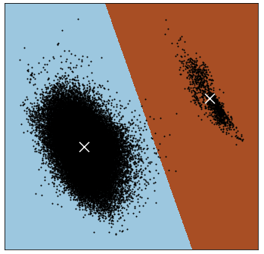
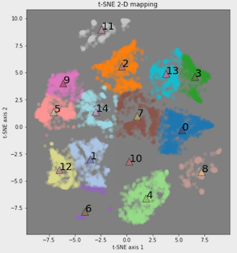
1. Introduction
1.1 Dimensionality reduction approaches
Linear mapping
Principal component analysis (PCA)
LDA, … …
Non-Linear mapping
t-SNE
Isomap, autoencoders, … …
1. Mapping images generated with dataset (https://archive.ics.uci.edu/ml/datasets/Online+News+Popularity)
2. Dimensionality reduction techniques: https://en.wikipedia.org/wiki/Dimensionality_reduction

Slide 4
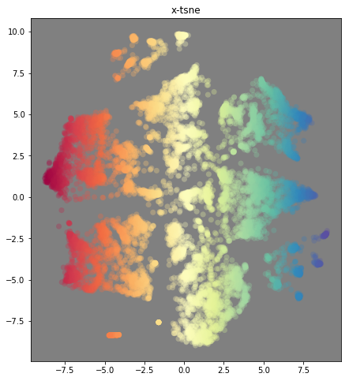
1.2 t-Distributed Stochastic Neighbor Embedding (t-SNE)
t-SNE, an improved version of SNE, was developed by van der Maaten and Hinton¹.
t-SNE is used for visualizing high D data into a low D space (2D or 3D).
t-SNE plots present dataset patterns with clusters.
High dimensional data
⇢
van der Maaten and Hinton. Journal of Machine Learning Research 9 (2008) 2579-2605
Image generated with dataset (https://archive.ics.uci.edu/ml/datasets/Online+News+Popularity)

Slide 5
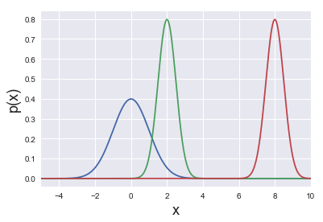
2. How Does t-SNE Algorithm Work Mathematically?
2.1 How to measure similarity for data points in high D Space
For given data points in high D space, the similarity between x_{i} and x_{i} can be calculated from the probability density under a Gaussian distribution centered at x_{i} with standard deviation σ_{i}.
If x_{i} and x_{j} are close, p_{j|i} is large;
If x_{i} and x_{j} are distant, p_{j|I} is small.
x_{i}
x_{j}
x_{j}’
van der Maaten and Hinton. Journal of Machine Learning Research 9 (2008) 2579-2605

Slide 6
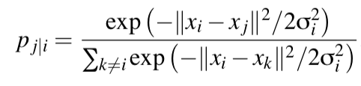
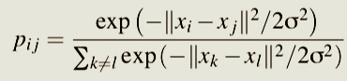
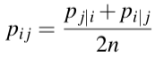
2.2 Define pairwise similarity in high D Space
SNE uses the conditional probability p_{j|I} to define pairwise similarity (x_{i} →x_{j} ) in high D space. The probability densities (x_{i} and x_{i}) are under a Gaussian distribution centered at x_{i} with variance σ_{i}².
t-SNE uses p_{ij} instead of p_{j|i}, and variance σ² instead of variance σ_{i}².
Data similarity matrix
|| x_{i} - x_{j} || is the Euclidean distance.
Define the joint probability p_{ij} to make the similarity matrix symmetric (n is the total number of data points).
All values in similarity matrix are between 0 and 1, and symmetry will simplify the gradient in learning stage.
van der Maaten and Hinton. Journal of Machine Learning Research 9 (2008) 2579-2605

Slide 7
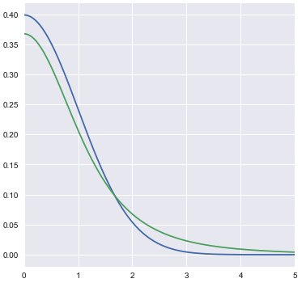
2.3 Use Gaussian distribution or t-distribution in low D plane?
PDF for Gaussian(0,1) and Student t (1 DOF)
The distance distribution is different between a high D space and a low D space.
Crowding problem^{1, 2} is a big disadvantage for SNE. For t-SNE, t-distribution is used instead of Gaussian distribution to prevent the imbalance in the distance distribution of a map point's neighbors.
Using t-distribution can make the cluster structure to be more separated, more stable and more reproducible.
near points → closer
P(x)
distant points → farther
x
1. Hinton and Roweis (2002): https://www.oreilly.com/learning/an-illustrated-introduction-to-the-t-sne-algorithm
2. van der Maaten and Hinton. Journal of Machine Learning Research 9 (2008) 2579-2605

Slide 8
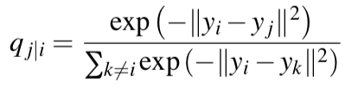
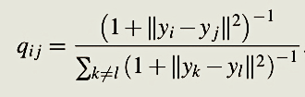
2.4 Measure similarities between low D points
In SNE, assume the projections of data points from high D space to a low D (2D or 3D) plane are samples from Gaussian distribution.
|∣y_{i}−y_{j}∣| is the Euclidean distance between the map points.
In t-SNE, assume the projections of data points from high D space to a low D (2D or 3D) plane are samples from a Student t-distribution (1 DOF) which is the same as a standard Cauchy distribution.
Map similarity matrix
The Student t-distribution is heavy-tailed and large distances are suppressed as a power law.
van der Maaten and Hinton. Journal of Machine Learning Research 9 (2008) 2579-2605

Slide 9
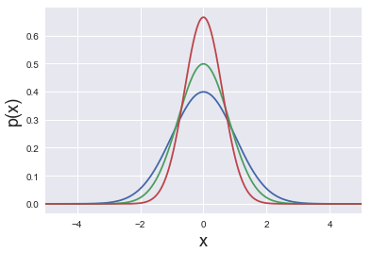
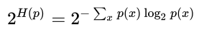
2.5.1 Perplexity across probability distributions
For data point x_{i,} standard deviation σ_{i} for dense clusters is smaller than for loose clusters.
Probability distribution P_{i} will be changed by different standard deviation σ_{i} values.
Red (σ₁ = 0.6), green (σ₂ = 0.8), blue (σ₃ = 1).
The perplexity of probability distribution is defined as:
where H(p) is the entropy of distribution and x ranges over events.
https://en.wikipedia.org/wiki/Perplexity

Slide 10
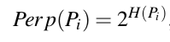
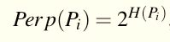
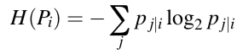
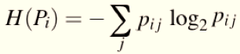
2.5.2 Perplexity to measure the effective number of neighbors
In SNE, use standard deviation σ_{i}. Probability distribution (P_{i}) will be changed by different standard deviation σ_{i} values. The perplexity is defined as:
For t-SNE, we use standard deviation σ for all the points.
where H(P_{i}) is given by the Shannon entropy of P_{i} which is measured by the number of binary partitions (bits)
The perplexity values are typically set between 5 and 50.
In t-SNE, the perplexity value is the numbers of nearest neighbors k (30 in sklearn).
van der Maaten and Hinton. Journal of Machine Learning Research 9 (2008) 2579-2605

Slide 11
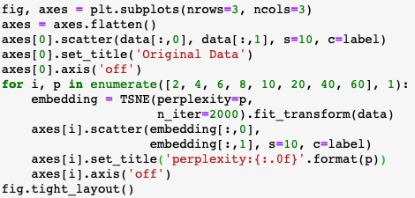
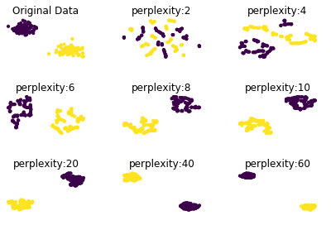
2.5.3 Perplexity^{1, 2}
1. Perplexity codes adapted and modified from book: Mastering Unsupervised Learning with Python, published by Packt
Github link: https://github.com/PacktPublishing/Mastering-Unsupervised-learning-with-Python/blob/master/Section%203/03_manifold_learning_tsne_umap.ipynb
2. t-SNE from sklearn: https://scikit-learn.org/stable/modules/generated/sklearn.manifold.TSNE.html

Slide 12
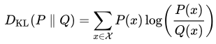
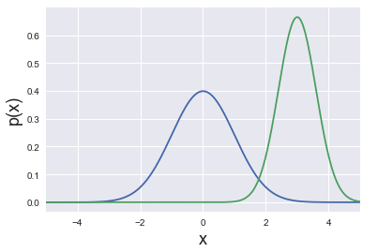
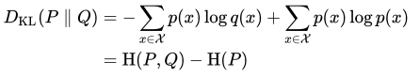
2.6.1 KL Divergence to measure the dissimilarity of two distributions
Kullback-Leibler (KL) divergence is a measure for dissimilarity between two distributions (P and Q), and the difference between cross-entropy H(P, Q) and the true distribution entropy H(P). It is not a distance.
P and Q are identical when KL divergence is zero.
KL divergence equation can also be interpreted as:
P(x)
Q(x)
https://en.wikipedia.org/wiki/Kullback–Leibler_divergence

Slide 13
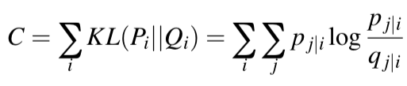
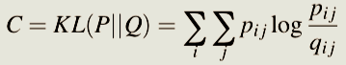
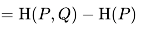
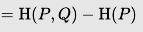
2.6.2 KL Divergence to measure the dissimilarity of two distributions
Kullback-Leibler (KL) divergence is a measure for dissimilarity between two distributions (P and Q), and the difference between cross-entropy H(P, Q) and the true distribution entropy H(P). It is not a distance.
SNE
t-SNE
Large p_{j/i} modelled by small q_{j/i} will lead to high cost (big penalty), small p_{j/i} modelled by large q_{j/I} will lead to low cost (small penalty).
p_{ij} is fixed and need to optimize the target distribution q_{j/i} by minimizing the sum of KL divergences (cost function).
Large p_{ij} modelled by small q_{ij} will lead to high cost (big penalty), small p_{ij} modelled by large q_{ij} will lead to low cost (small penalty).
p_{ij} is fixed and need to optimize the target distribution q_{ij} by minimizing the sum of KL divergences (cost function).
van der Maaten and Hinton. Journal of Machine Learning Research 9 (2008) 2579-2605

Slide 14
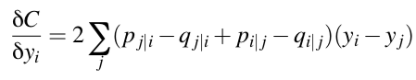
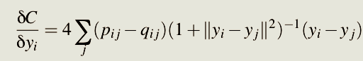
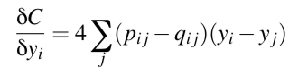
2.7 Gradient descent optimization of KL divergence
Optimize cost function C with respect to the choice of points {y_{i}} using a gradient descent optimization method. In SNE, the gradient values are calculated as:
Asymmetric
t-SNE
Symmetric
Compression | Spring
Positive value means attraction, and negative value means repulsion.
Positive value means attraction, and negative value means repulsion.
van der Maaten and Hinton. Journal of Machine Learning Research 9 (2008) 2579-2605

Slide 15
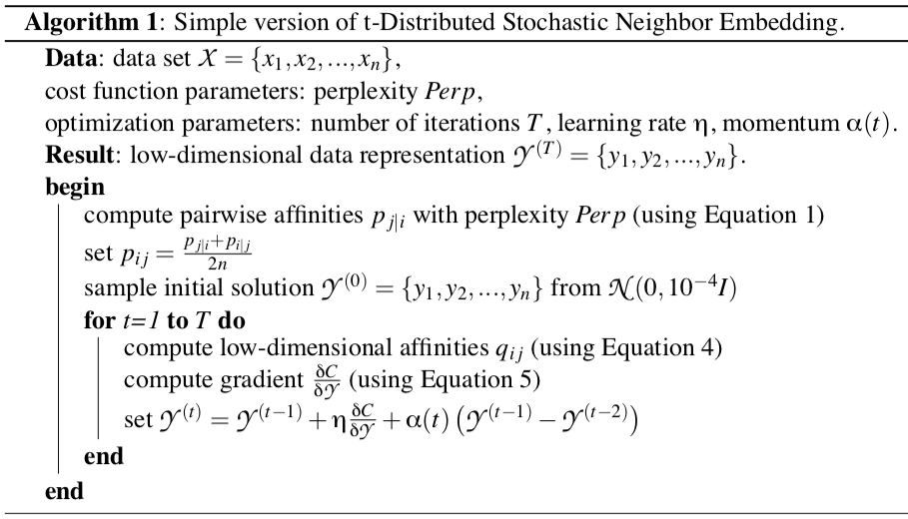
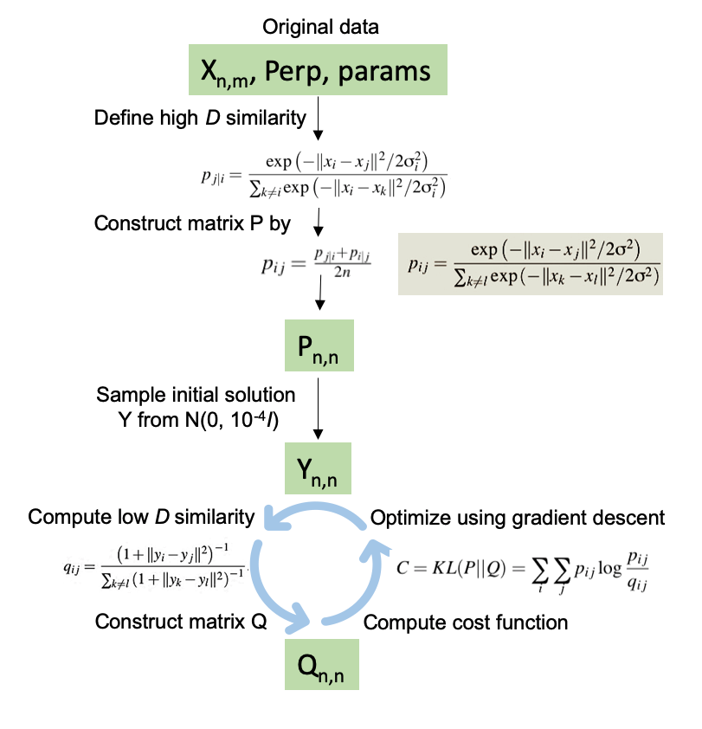
2.8. The basic t-SNE algorithm workflow
van der Maaten and Hinton. Journal of Machine Learning Research 9 (2008) 2579-2605

Slide 16
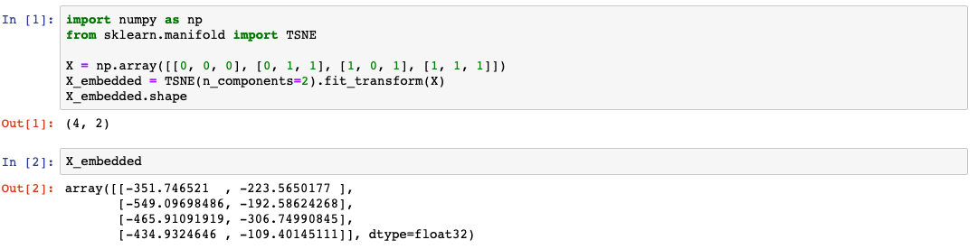
2.9. t-SNE implementation
t-SNE has been implemented in¹:
Python, R, Java, JavaScript, MATLAB, CUDA, Go, Torch, Julia.
In Python environment, optimize t-SNE with parameters:
perplexity, early exaggeration factor, learning rate, and maximum number of iterations.
Code example²:
1. t-SNE implementation: https://lvdmaaten.github.io/tsne/.
2. https://scikit-learn.org/stable/modules/generated/sklearn.manifold.TSNE.html

Slide 17
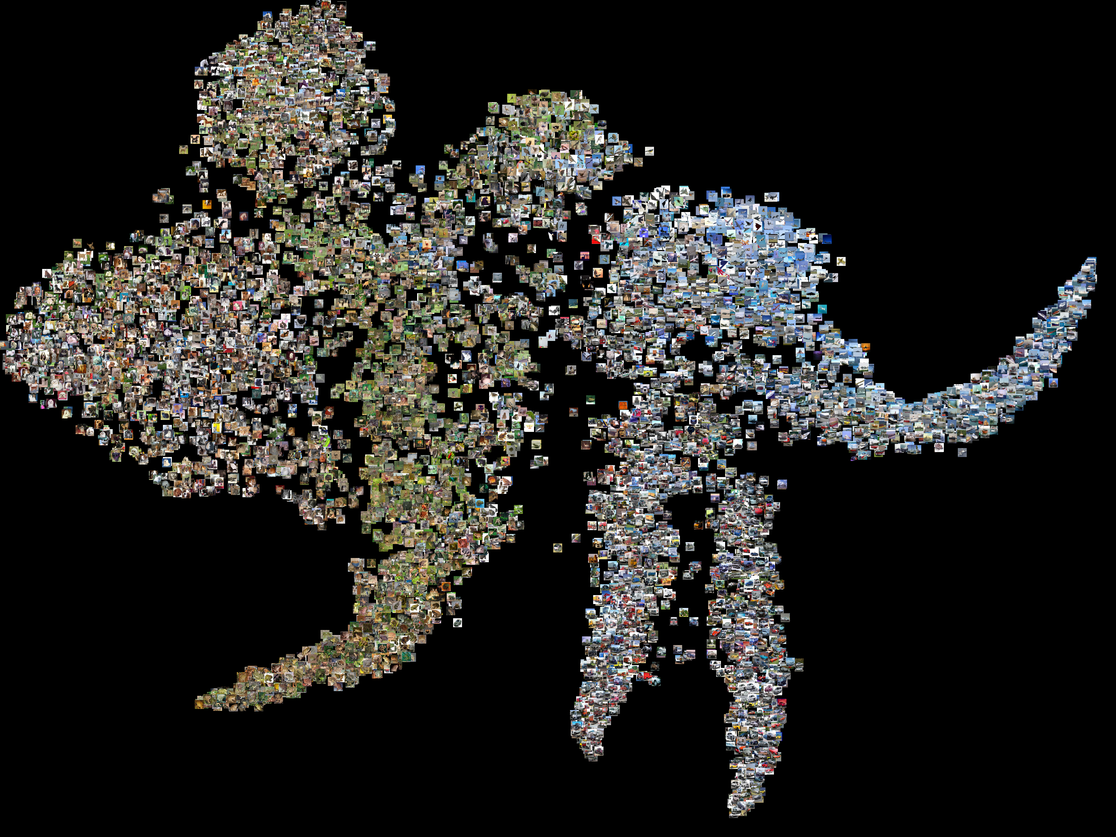
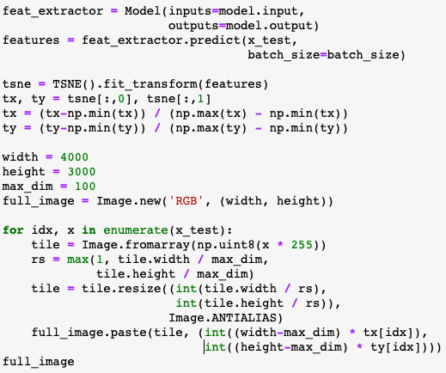
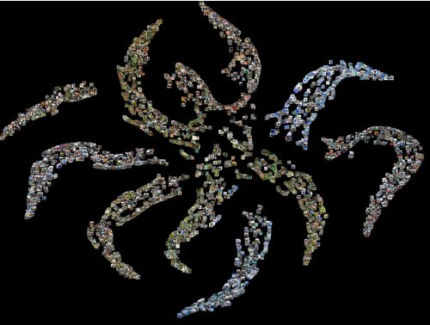
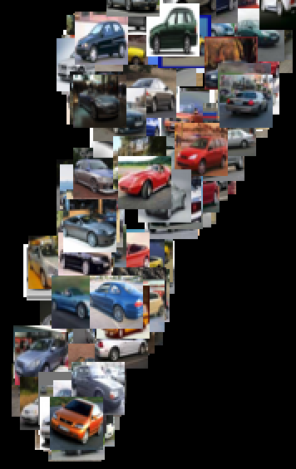
3. t-SNE Demonstration Examples
3.1 Visualization of CNN output features on CIFAR-10 using t-SNE^{1, 2, 3}
CNN model output Partial zoomed view
1. CIFAR-10 dataset: https://www.cs.toronto.edu/~kriz/cifar.html
2. CNN and t-SNE codes adapted and modified from Philip Slingerland: medium.com/@pslinge144/representation-learning-cifar-10-23b0d9833c40
3. t-SNE from sklearn: https://scikit-learn.org/stable/modules/generated/sklearn.manifold.TSNE.html

Slide 18
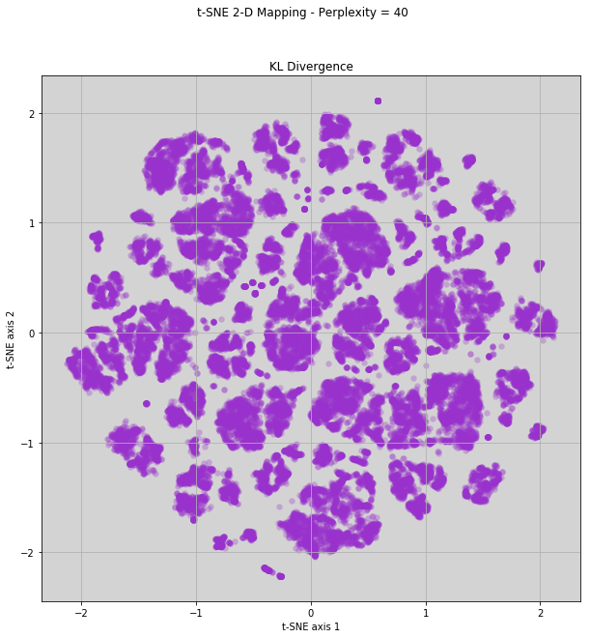
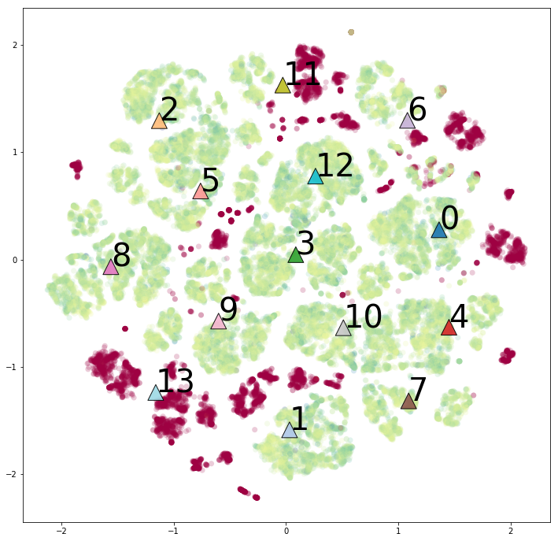
3.2 Combine PCA and t-SNE in dimensionality reduction
Compare PCA with t-SNE
Combine PCA and t-SNE to visualize data
PCA
n_components = 20
t-SNE
Perplexity = 40, KL divergence is 2.6 after 500 iterations)
 | PCA | t-SNE
Dimensionality reduction | Variance | Probability
Data for mapping | linear | Non-linear
Visualization | Not always | Good
Computation | Fast | Slow
In practice | Effective | Good
Host tools | Start point | Yes
PCA and t-SNE
Feature distribution
Mapping images generated with dataset
(https://archive.ics.uci.edu/ml/datasets/Online+News+Popularity)

Slide 19
4. Summary and Further Notes for t-SNE Algorithm
A complex dataset can be visualized effectively by the t-SNE algorithm in 2D (or 3D with better results, Ref. 3), uncovering hidden patterns with clusters.
t-SNE is not scalable in its basic form due to complexity scale as N². For applying to large datasets, van der Matten introduced tree-based algorithm by using Barnes-Hut approximation (Ref. 5).
t-SNE visualization results depend on perplexity values (default value is 30 in sklearn).
t-SNE preserves nearest neighbors but not distance. Clustering on the output of t-SNE with distance or density-based clustering algorithms (e.g. K-means or DBSCAN) may cause problems.
t-SNE algorithm cannot visualize high D data in real time.

Slide 20
More references and helpful links for t-SNE
Laurens van der Maaten: https://lvdmaaten.github.io/tsne/
van der Maaten and Hinton. Journal of Machine Learning Research 9 (2008) 2579-2
3D deep learning visualization with t-SNE: https://www.youtube.com/watch?v=s7PKqXD2drs
Lecture from Ali Ghodsi: https://www.youtube.com/watch?v=4GBgqmq0XAY3
van der Maaten. Journal of Machine Learning Research 15(Oct):3221-3245, 2014
van der Maaten. 2012 IEEE international workshop on machine learning for signal processing (2012).
Dimensionality reduction: https://en.wikipedia.org/wiki/Dimensionality_reduction
t-SNE from sklearn: https://scikit-learn.org/stable/modules/generated/sklearn.manifold.TSNE.html

